Slide 1

Mindlancer: Connecting Talent with Opportunity
Mindlancer is a platform designed to connect skilled freelancers with businesses and project owners. Our goal is to create a seamless experience for both parties. We aim to empower freelancers to showcase their talents and enable businesses to find the perfect match for their projects.

Slide 2



Key User Roles on Mindlancer
Freelancers
Businesses/Project Owners
Admin
Software developers seeking diverse projects. They create profiles showcasing skills and experience.
Companies and individuals needing software development expertise. They post projects and hire talent.
Platform managers overseeing users and projects. They handle disputes and enforce platform policies.

Slide 3




Seamless User Management
Freelancer Profile
Business Profile
Admin Panel
Sign up via email, LinkedIn, or GitHub. Showcase skills, experience, and portfolio.
Register via email or business LinkedIn. Company profile includes industry and hiring needs.
Manage users, approve accounts, and handle platform settings efficiently.

Slide 4

Efficient Job Posting & Search
1
Job Posting
2
Freelancer Search
Businesses create detailed job posts. Include skills, budget, and deadlines.
Freelancers search by skill, budget, and location. Save listings for later.
3
Direct Application
Freelancers directly apply for jobs matching their expertise. Streamlined process.

Slide 5




Streamlined Bidding & Hiring
Proposal Submission
Freelancers submit detailed proposals. Include cover letter and bid amount.
Shortlisting
Businesses review proposals and profiles. Schedule interviews.
Job Offer
Send job offers to selected freelancers. Integrated chat/video call.

Slide 6

Technology Stack & UI/UX Design
Frontend
React.js + Bootstrap for a responsive user interface.
Backend
Node.js for robust server-side logic.
Database
MongoDB for flexible data storage.
UI/UX Design
Interactive prototype using Figma or Adobe XD.

Slide 7









Freelance Platform Workflow
User Registration
New users create accounts with basic info.
Profile Setup & Approval
Admins approve detailed profiles for quality.
Job Posting & Search
Clients post projects; freelancers seek opportunities.
Freelancer Bidding
Freelancers propose approach, timeline, and pricing.
Hiring
Clients select qualified freelancers.
Project Execution
Freelancers complete projects, meeting milestones.
Payment Processing
Clients release funds via secure gateways.
Reviews & Ratings
Clients and freelancers provide feedback.
Admin Management
Admins oversee, manage disputes, and improve UX.

Slide 8

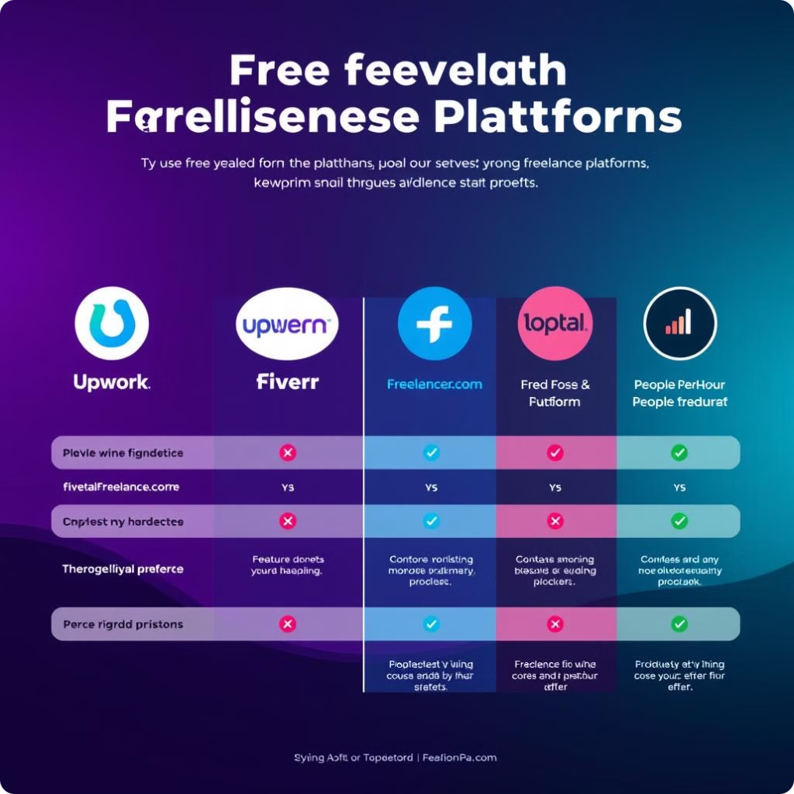
Comparison of Freelance Platforms
Platform
Features
Limitations
Upwork
Job postings, bidding, payments, dispute resolution
High service fees, complex bidding
Fiverr
Gig-based hiring, pre-defined service packages
Small tasks, limited negotiation
Toptal
Exclusive talent, rigorous screening, premium clients
High barrier to entry
Freelancer.com
Bidding, contests, membership plans
High competition, spam job posts
PeoplePerHour
AI-based matching, escrow system
Limited job categories, high withdrawal fees

Slide 9
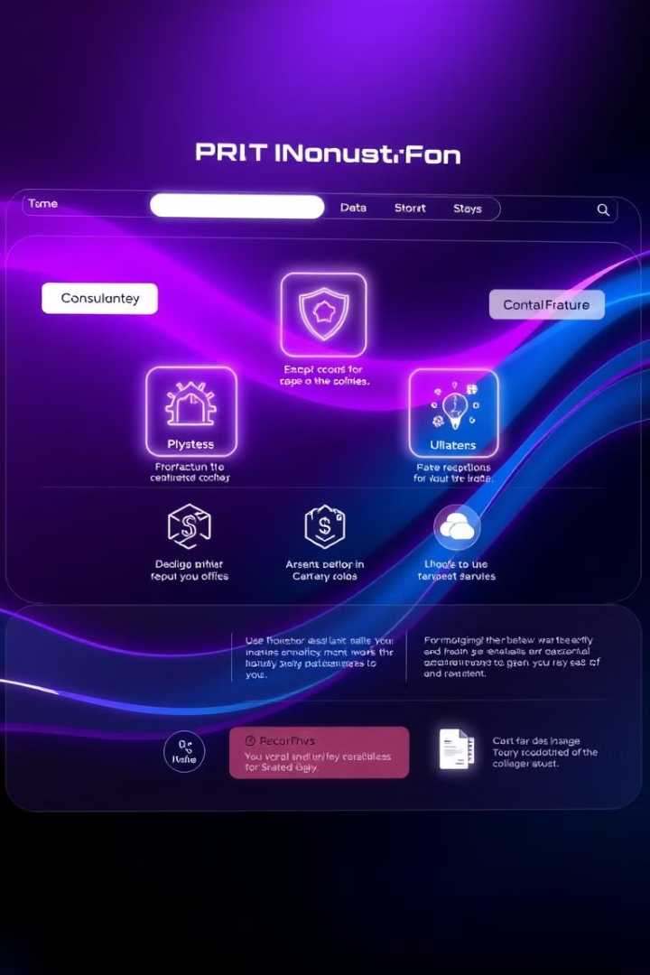
Mindlancer's Innovations
Feature
Existing Platforms
Mindlancer's Innovation
AI-Powered Matching
Limited AI
Advanced ML-based matching
Blockchain Payments
Standard escrow
Smart contracts for secure payments
Identity Verification
Manual verification
Blockchain-backed verification
AI Resume Optimizer
None
AI suggestions for proposals
Integrated Chat
Available in Upwork
Real-time chat, scheduling, video
Skill Certifications
Available
Blockchain-backed certifications
Transparent Reviews
Some allow editing
Blockchain-based reviews
Multi-Currency Payments
Limited to PayPal, Stripe
Supports crypto payments
Freelancer Analytics
Basic reporting
Advanced insights on performance

Slide 10
Mindlancer's Value Proposition
For Freelancers
For Businesses
For Admins
AI-driven job recommendations.
Verified talent with skill assessments.
AI-based fraud detection.
Lower service fees.
Dispute resolution with blockchain.
Secure payments & verified clients.
Fast hiring with AI recommendations.
Automated job approval.
Smart contracts for secure payments.

Slide 11

Development Roadmap
1
Phase 1 (2-3 Months)
User authentication.
Job posting & application.
Payment processing.
Admin dashboard.
2
Phase 2 (3-6 Months)
AI-powered matching.
Smart contract payments.
Real-time chat & video.
Skill assessment system.
3
Phase 3 (6+ Months)
Mobile app version.
Performance analytics.
Global expansion.

Slide 12
Mindlancer.com is designed to be a cutting-edge freelance marketplace that seamlessly connects skilled freelancers with businesses looking for top talent. By integrating AI-powered job matching, blockchain-secured payments, and a user-friendly hiring process, the platform ensures efficiency, security, and transparency for all users. With structured workflows for job postings, bidding, hiring, and dispute resolution, Mindlancer.com creates a seamless experience that fosters trust and collaboration. Leveraging modern technologies like React.js, Next.js, FastAPI/Django, and PostgreSQL, the platform is built for scalability and reliability. As we move forward, the focus will be on UI/UX design and backend development to bring this vision to life, making Mindlancer.com a game-changer in the freelancing industry. 🚀

